Slide 1
Briefing
Kee Chun Yun
28 Sep 2024

Slide 2
Three Body Problem (Gravitational)
N-body problem studies the motion of a group of N objects interacting with each other gravitationally.
2 body problem (N=2), we have analytical solution, Allow us to orbit around earth but break down as soon as we want to go to moon
3 body problem (N=3), represents the simplest instance of general N-body problem that has no general closed form solution
Other than gravitational case: 3 Charged particles (Coulomb forces), Double pendulum + spring mass (elastic forces), suspended 3 droplets (hydrodynamic forces + van der Waals forces), ? (magnetic forces), 3 species predator-prey, etc

Slide 3
Kickstarting with CR3BP
To start with Circular Restricted 3 Body Problem (CR3BP) which consists of two 2nd order ODEs which is still relevant in practice
To familiarize students with
converting higher order ODE to a system of first order ODEs
converting ODE to fractional form
solving first order ODE system with MATLAB
Some relevant references:
https://orbital-mechanics.space/the-n-body-problem/circular-restricted-three-body-problem.html
https://gereshes.com/2018/10/22/introduction-to-the-3-body-problem/
https://gereshes.com/2018/11/12/dynamics-of-the-3-body-problem/
Alternative formulation: “Satellite orbits in Levi-Civita space.pdf”

Slide 4
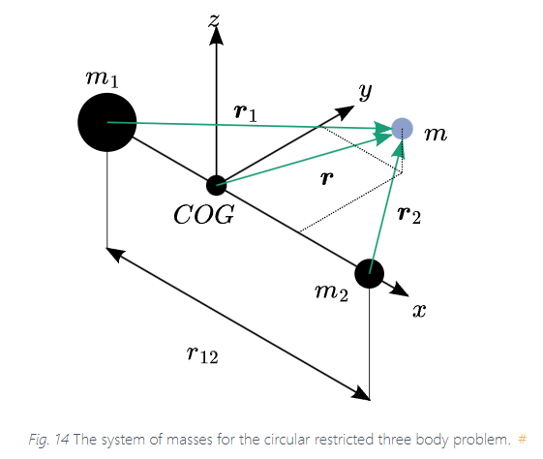
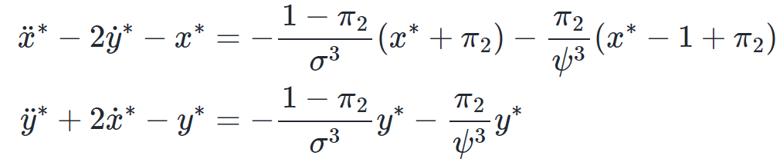
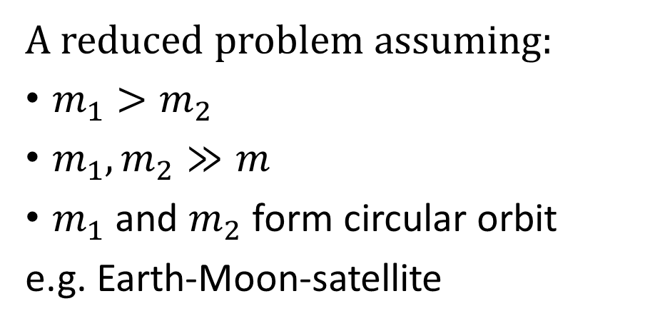
Circular Restricted 3 Body Problem (CR3BP)
A reduced problem assuming:
$m_{1}>m_{2}$
$m_{1},m_{2}≫m$
$m_{1}$ and $m_{2}$ form circular orbit
e.g. Earth-Moon-satellite
Governing Equations
Refer to the link below for the symbols and derivation:
https://orbital-mechanics.space/the-n-body-problem/circular-restricted-three-body-problem.html

Slide 5
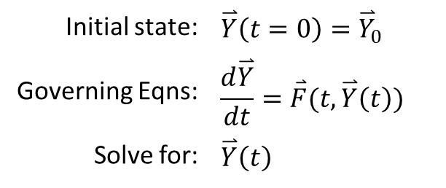
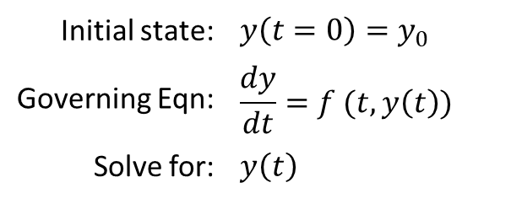
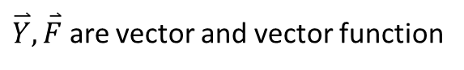
3 Body problem as IVP
Initial Value Problem (IVP)
Given the initial state (or initial values) of the 3 bodies (i.e. the positions and velocities), we want to predict the trajectory of the 3 bodies
Eqns in previous slide can be written into this form i.e. a system of first order ODE
1 Dimensional IVP
N Dimensional IVP
Initial state: | $$y\left(t=0\right)=y_{0}$$
Governing Eqn: | $$\frac{dy}{dt}=f (t,y\left(t\right))$$
Solve for: | $$y\left(t\right)$$
Initial state: | $$\overset{⃑}{Y}\left(t=0\right)={\overset{⃑}{Y}}_{0}$$
Governing Eqns: | $$\frac{d\overset{⃑}{Y}}{dt}=\overset{⃑}{F}(t,\overset{⃑}{Y}\left(t\right))$$
Solve for: | $$\overset{⃑}{Y}\left(t\right)$$
$\overset{⃑}{Y},\overset{⃑}{F}$ are vector and vector function

Slide 6
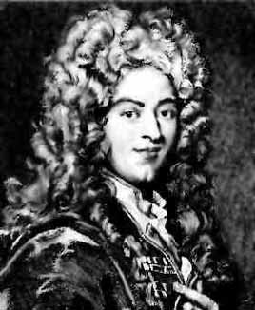
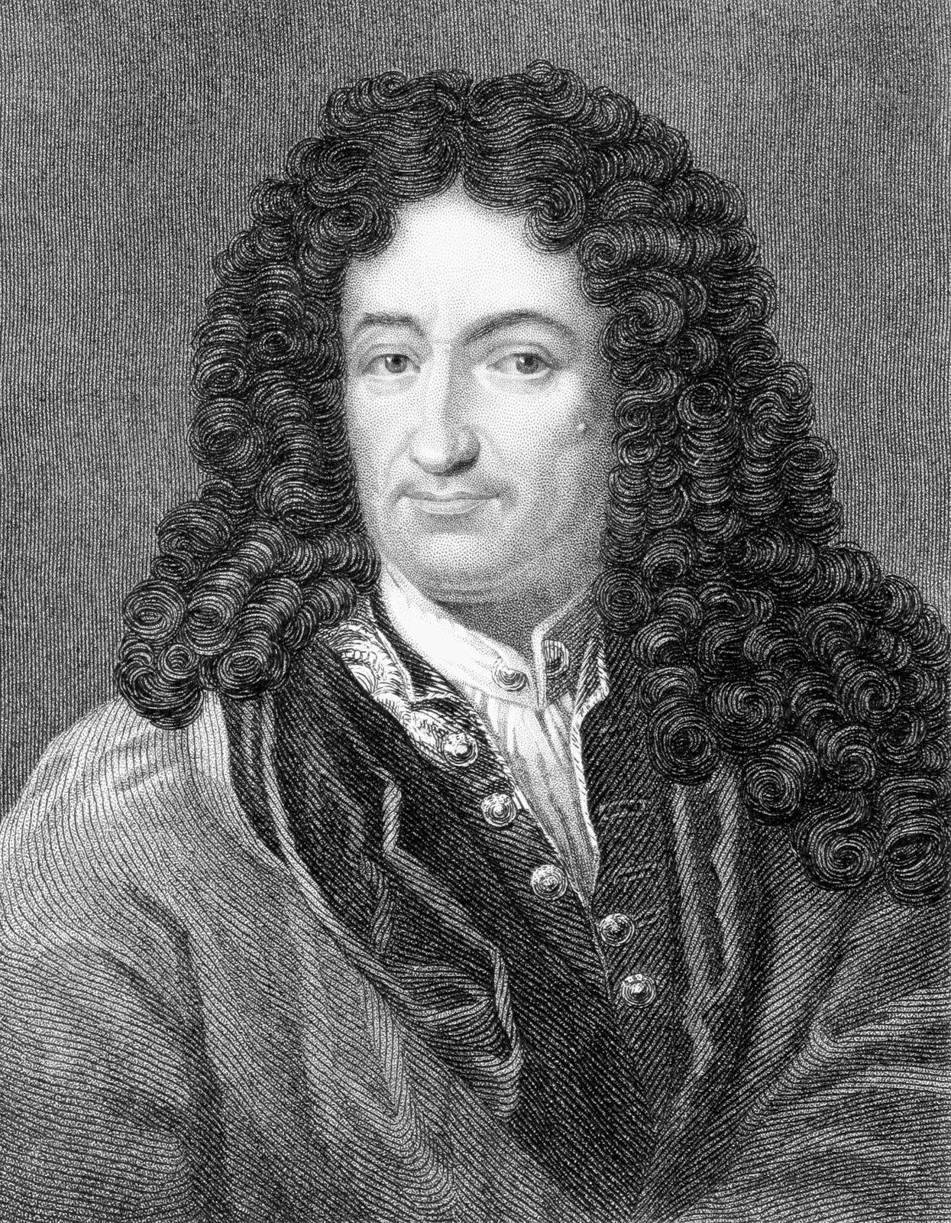
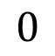
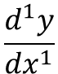
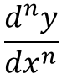
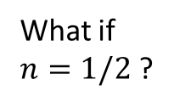
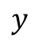

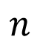
Fractional Calculus
To study behaviour of physical systems that are determined by integration and/or differentiation of non-integer orders
First appeared in letter exchange between L’Hopital and Leibniz
Applied to describe objects with roughness, disorder, fractal property and system with memory, non-locality, long range interaction.
$$\frac{d^{n}y}{dx^{n}}$$
$$\frac{d^{1}y}{dx^{1}}$$
$$y$$
$$0$$
$$n$$
$$1$$
What if $n=1/2$ ?
It will lead to a paradox which one day useful consequences will be drawn
L’Hopital 1661-1704
Leibniz 1646-1716
Notes:
I will start with a brief introduction to fractional calculus
We are familiar with standard calculus that compute first order, second order derivative, for example in high school , we differentiate displacement we get velocity, we differentiate velocity we get acceleration.
Contrast to that, fractional calculus is a branch of mathematics that study the derivative that the order is not an integer, but fractional, in fact it can be complex and can be non-constant as well.
It all started in 1695 with a question asked by Lhopital to Leibniz about what one would obtain if the order of derivatives is half.
This marked the beginning of the field.
The development of this field has been long but uncommon/unpopular

Slide 7
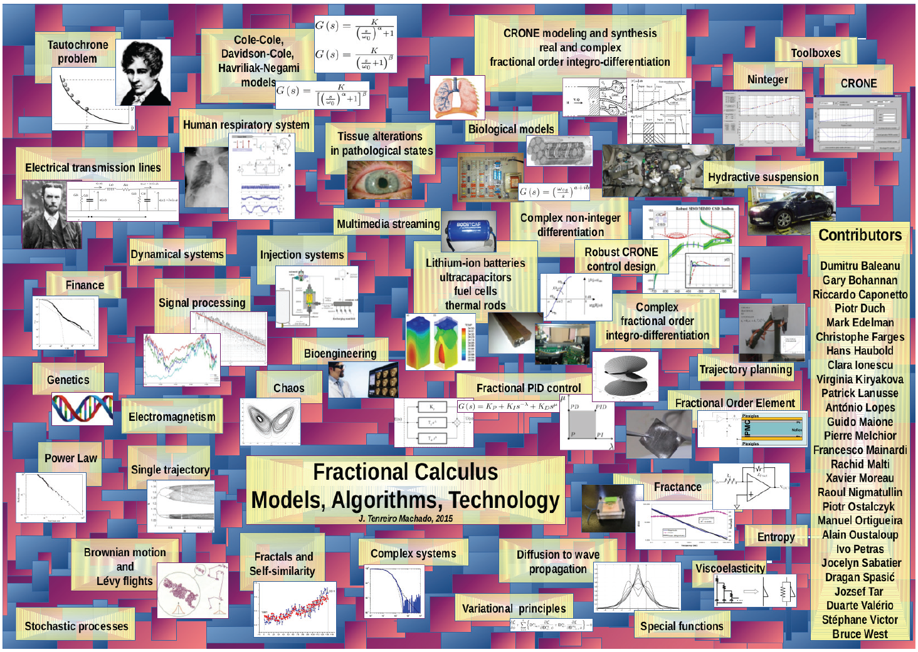
Applications
J. A. T. Machado, DNC 4, 383 (2015)
Notes:
Fractional calculus has found many application in many different field,
Some examples are viscoelastic material, pharmocokinetics in biological system, battery, electrical circuit, anamolous diffusion, finance etc
They are most often associated with nonlocaility, memory effect, roughness, fractal objects, porous disordered material, complex system

Slide 8
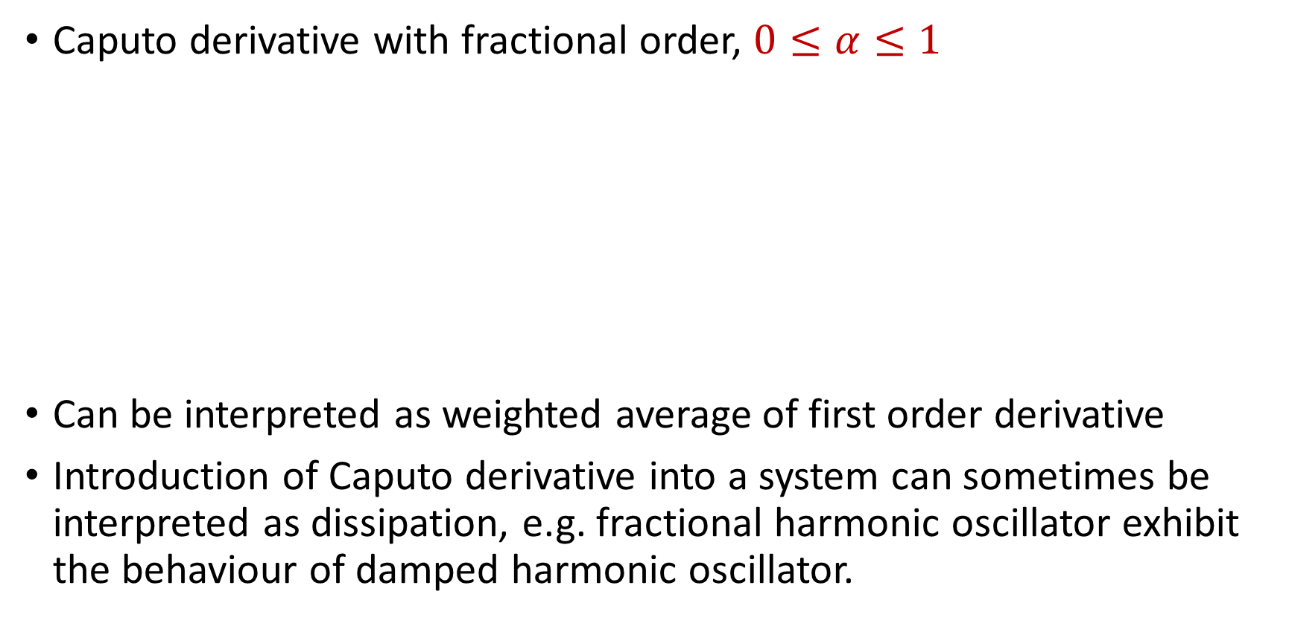

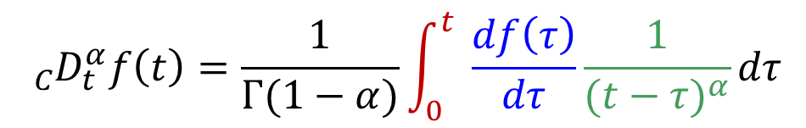
Caputo Fractional Derivative
Caputo derivative with fractional order, $0≤α≤1$
Can be interpreted as weighted average of first order derivative
Introduction of Caputo derivative into a system can sometimes be interpreted as dissipation, e.g. fractional harmonic oscillator exhibit the behaviour of damped harmonic oscillator.
$${}_{C}^{}{D_{t}^{α}}f\left(t\right)=\frac{1}{Γ(1−α)}\int_{0}^{t}{ }\frac{df\left(τ\right)}{dτ}\frac{1}{{(t−τ)}^{α}}dτ$$
Integral: dependence on historical state
Standard derivative
Decaying weights: smaller when further away from $t$
Notes:
First of all, there are many flavours of fractional derivatives, there are mainly developed for different purpose for specific application.
The three most established and popular one are Riemann-Liouville, Grunwald-Letnikov and Caputo
Caputo being the most favorable on in engineering application. Is also what we will take a closer look.
We use D with a C here to denote the Caputo derivative. The alpha is the order of the derivative, f(t) is the function that the operator operate on, follow by on the righ hand side the definition of the Caputo derivative
It certainly has become more involved but the good there are more or less the symbols we familiar with.
Except perhaps the symbols looks like R here, which is called gamma function which is a normalizing constant here.
If we think of integral as a summation, we are performing an average over all the derivative up to the time of interest weighted by a function 1 over t-tau to the power of alpha, also known as a power law function.
As alpha change from 0 to 1,
This definition also highlight the dependence of history, where we sum over the first derivative of all previous time.
It does recover back the standard definition of
Note that for the cases of alpha=0 and 1, direct substitution will not work. But we have consider the limit of the expression and apply Leibniz rule but we will not go into the details here.

Slide 9
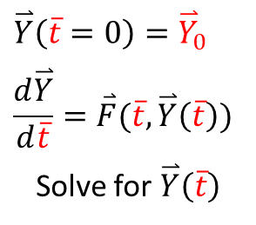
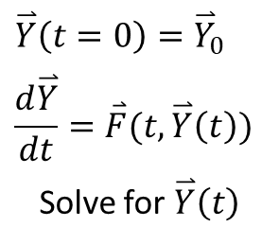
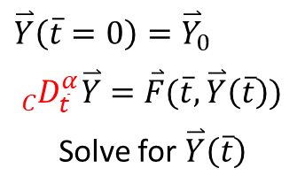
Converting ODEs to Fractional Form
Fractional operator introduces fractional dimension to “t” (time in our context), the variable we differentiate with respect to
Conversion can be done by replacing differential operator in the normalized (at least normalized t) ODE system
Remember to adjust initial condition
Original
Normalized
Fractional
IVP
IVP
IVP
$$\overset{⃑}{Y}\left(t=0\right)={\overset{⃑}{Y}}_{0}$$
$$\frac{d\overset{⃑}{Y}}{dt}=\overset{⃑}{F}(t,\overset{⃑}{Y}\left(t\right))$$
Solve for $\overset{⃑}{Y}\left(t\right)$
$$\overset{⃑}{Y}\left(\overline{t}=0\right)={\overset{⃑}{Y}}_{0}$$
$$\frac{d\overset{⃑}{Y}}{d\overline{t}}=\overset{⃑}{F}(\overline{t},\overset{⃑}{Y}\left(\overline{t}\right))$$
Solve for $\overset{⃑}{Y}\left(\overline{t}\right)$
$$\overset{⃑}{Y}\left(\overline{t}=0\right)={\overset{⃑}{Y}}_{0}$$
$${}_{C}^{}{D_{\overline{t}}^{α}}\overset{⃑}{Y}=\overset{⃑}{F}(\overline{t},\overset{⃑}{Y}\left(\overline{t}\right))$$
Solve for $\overset{⃑}{Y}\left(\overline{t}\right)$
The solution is in normalized t

Slide 10
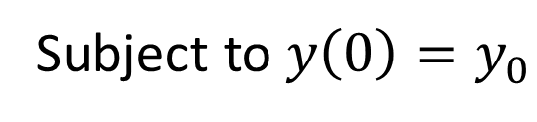
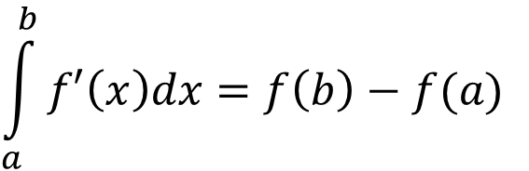
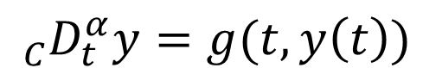
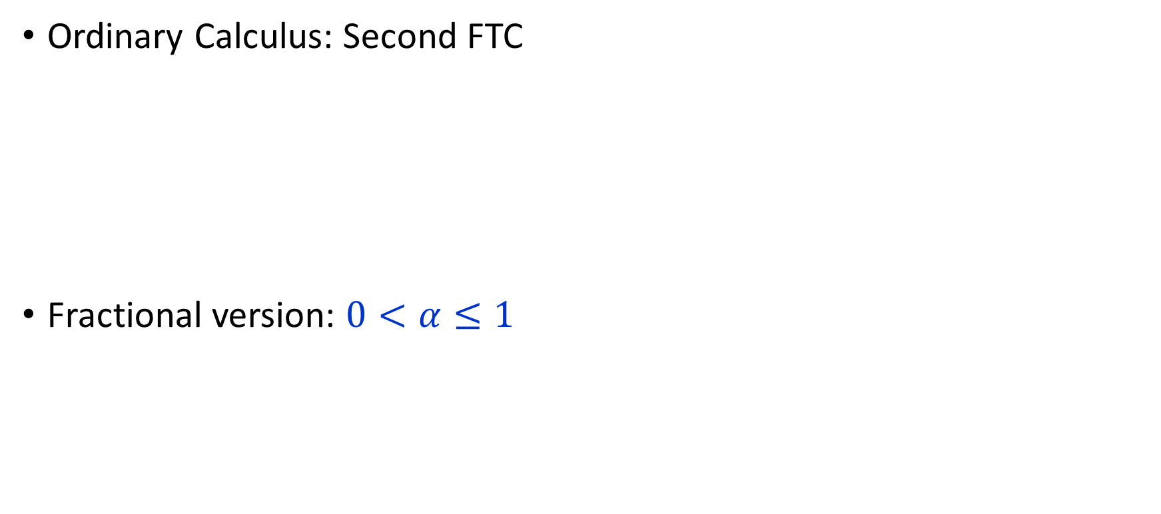
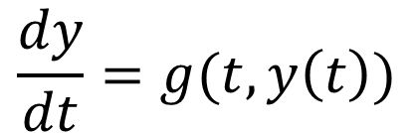
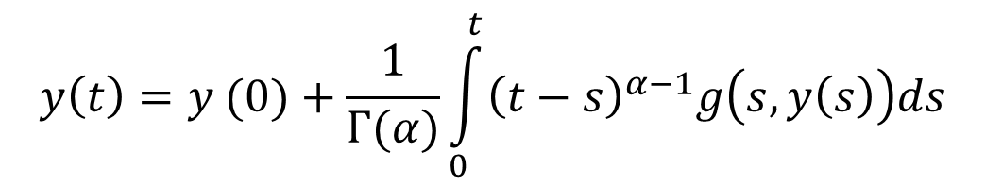
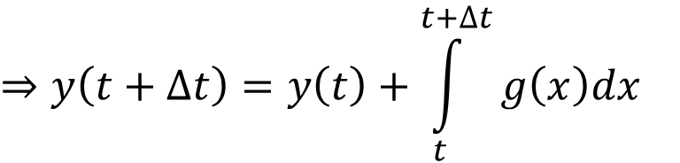
Solving Initial Value Problem
IVP
$$\frac{dy}{dt}=g(t,y\left(t\right))$$
OR
Ordinary Calculus: Second FTC
Fractional version: $0<α≤1$
$${}_{C}^{}{D_{t}^{α}}y=g(t,y\left(t\right))$$
$$\int_{a}^{b}{f′\left(x\right)dx}=f\left(b\right)−f(a)$$
Subject to $y\left(0\right)=y_{0}$
$$⇒y\left(t+∆t\right)=y\left(t\right)+\int_{t}^{t+∆t}{g\left(x\right)dx}$$
Many of the numerical methods for solving IVP and fractional IVP are based on this two identities.
*We will use existing solvers.
$$y\left(t\right)=y (0)+\frac{1}{Γ(α)}\int_{0}^{t}{{\left(t−s\right)}^{α−1}g\left(s,y\left(s\right)\right)ds}$$
This integral involves the entire history from the beginning of the system

Slide 11
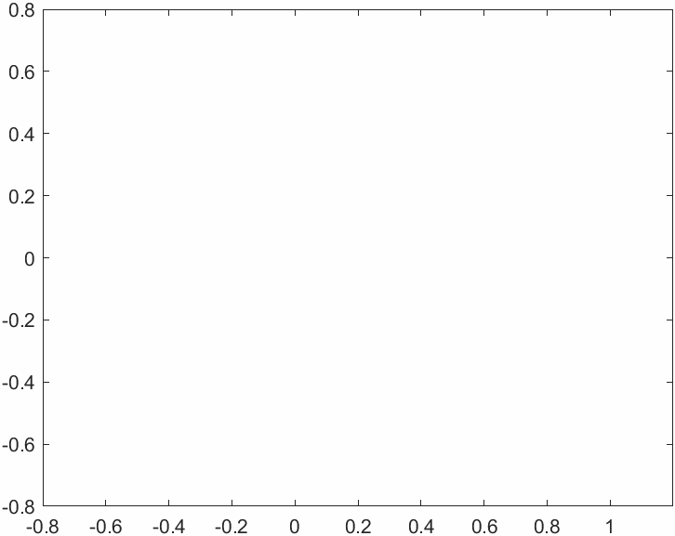
Example 1 (CR3BP)
Normalized y
Normalized x
Source file: CR3BP.m
Source file: plot_animated_CR3BP.m

Slide 12
Example 2 (fractional CR3BP)
Normalized y
Normalized x
Source file: FracCR3BP.m
Source file: plot_animated_FracCR3BP.m
Jacobian derived in jacobian_FracCR3BP.m

Slide 13
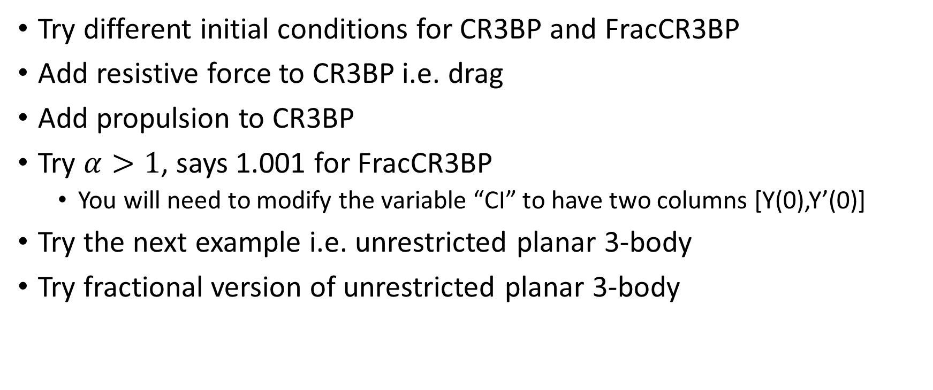
Some ideas for exploration
Try different initial conditions for CR3BP and FracCR3BP
Add resistive force to CR3BP i.e. drag
Add propulsion to CR3BP
Try $α>1$, says 1.001 for FracCR3BP
You will need to modify the variable “CI” to have two columns [Y(0),Y’(0)]
Try the next example i.e. unrestricted planar 3-body
Try fractional version of unrestricted planar 3-body

Slide 14
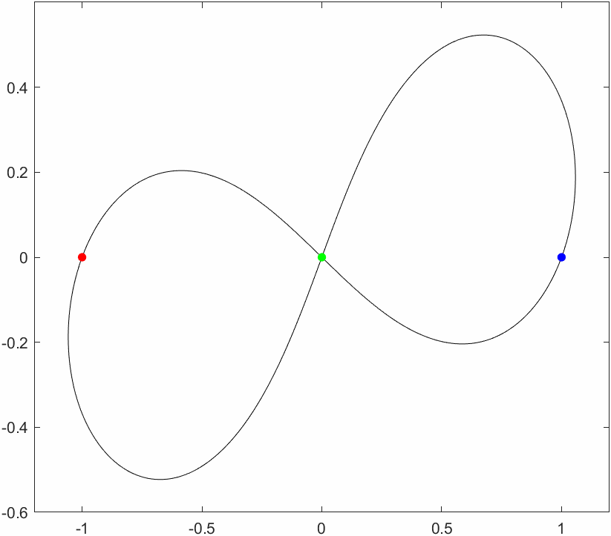
Example 3 (unrestricted planar 3BP)
Source file: figure_eight.m

